Slide 1

Artificial Intelligence Uninformed Search
CS 444 – Spring 2021
Dr. Kevin Molloy
Department of Computer Science
James Madison University
Much of this lecture is taken from
Dan Klein and Pieter Abbeel AI class

Slide 2
Announcements
HW 0 is due tonight (from last lecture and Chp 2 in Russell/Norvig).
PA 0 is due tomorrow Friday, Jan 22
PA 1 is released. You should start on the project now.
No quiz this week (want to get back some HW to you first).

Slide 3
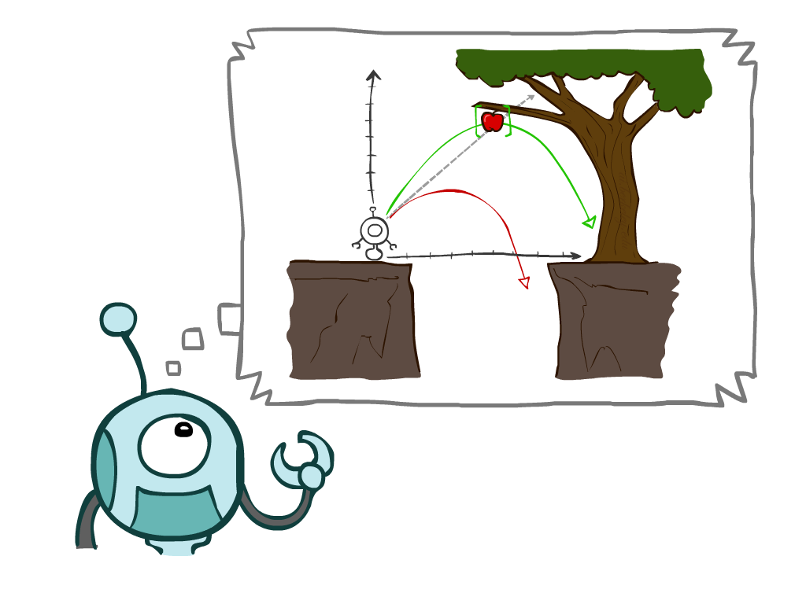
Learning Objectives for Today
More on Reflex and other agents
Define a search problem
Uninformed Search Methods:
Depth-first search
Breadth-first search
Iterative Deeping Search
Uniform-Cost search
Figure from Berkley AI

Slide 4

Reflex Agents
Reflex agents:
Choose action based on current percept (and maybe memory)
May have memory or a model of the world's current state
Do not consider the future consequences of their actions
Summary: They consider how the world IS right now.
Question: Can a reflex agent be rational?
Figure from Berkley AI

Slide 5
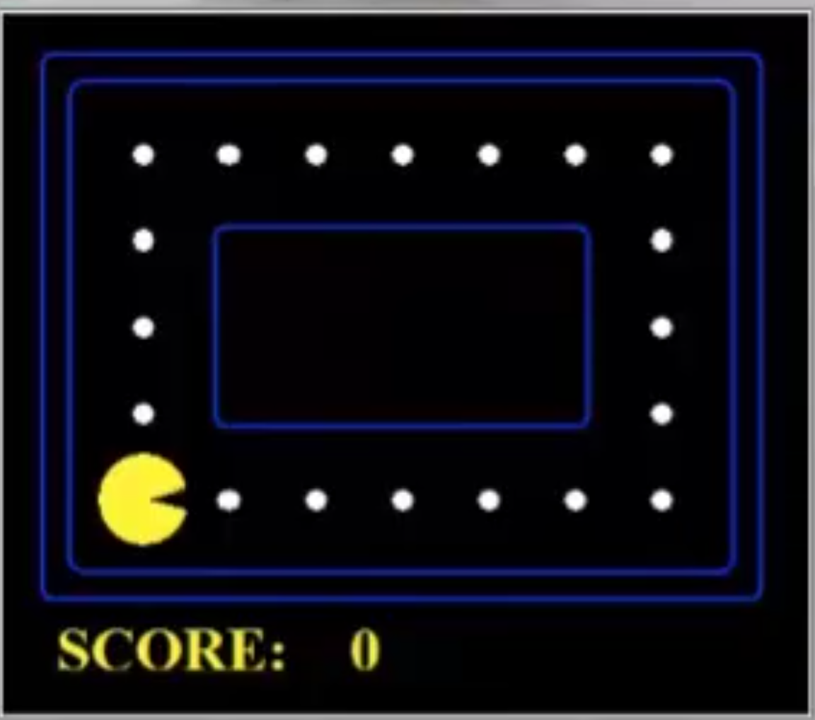
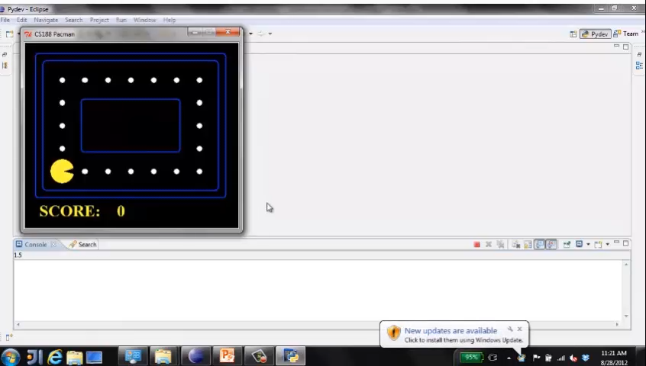
Video of Reflex Agent that is Optimal
Question: Can a reflex agent be rational?
Strategy: Move towards the nearest food pellet
Figure from Berkley AI

Slide 6
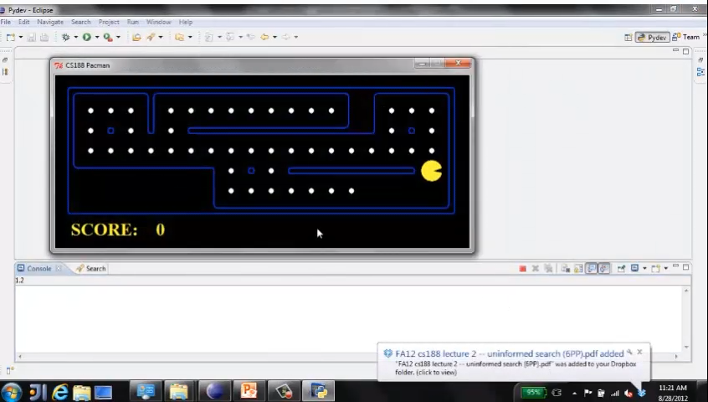
Reflex Agent in a Different Environment
Figure from Berkley AI

Slide 7
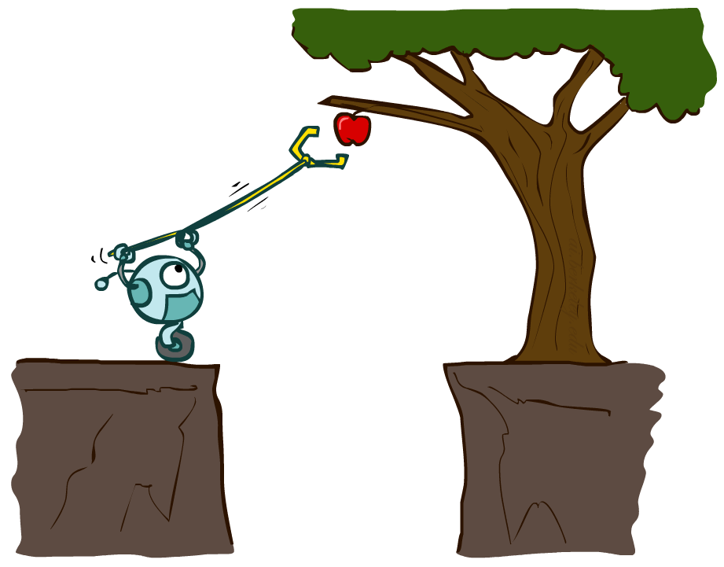
Planning Agents
Planning agents:
Ask "what if"
Decisions based on (hypothesized) consequences of actions
Must have a model of how the world evolves in response to actions
Must formulate a goal (test)
Consider how the world WOULD BE
Optimal vs. complete planning
Planning vs replanning
Much of this slide from Berkley AI

Slide 8
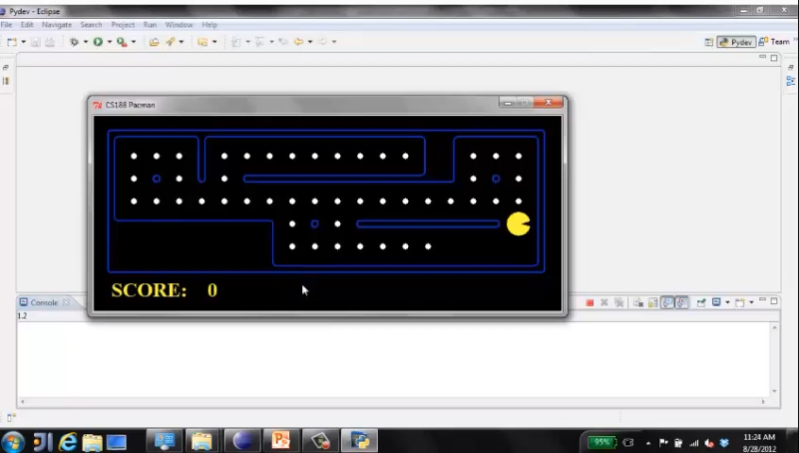
Replanning in Pacman
After eating each dot, plan again (replan) on how to get to the nearest dot.
Question: Does this agent act rationally/optimally?
Much of this slide from Berkley AI

Slide 9
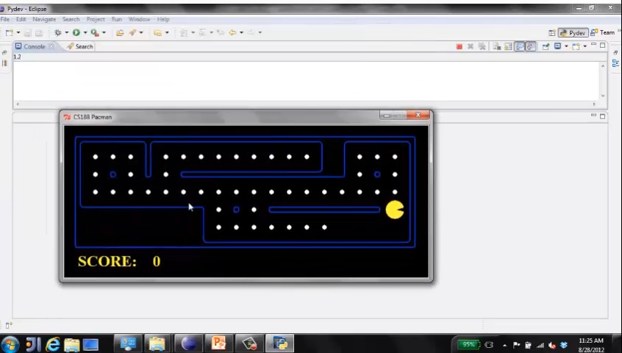
Complete Planning
Construct a global plan to get all the dots. Evaluate all plans and pick the optimal plan.
Question: Is this really an option generally speaking?
Much of this slide from Berkley AI

Slide 10

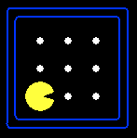





Search Problems
A search problem consists of:
A state space
“N”, 1.0
A successor function (with actions, costs)
“E”, 1.0
A start state and a goal test
A solution is a sequence of actions (a plan) which transforms the start state to a goal state.
Much of this slide from Berkley AI

Slide 11

Search Problems are Models
Models are discrete approximations of the real world.
Much of this slide from Berkley AI

Slide 12
Example: Traveling in Romania
State space:
Cities
Successor function:
Roads connecting adjacent city with cost = distance
Start state:
Arad
Goal test:
Is state == Bucharest
Solution: How do we solve this problem?
Much of this slide from Berkley AI and Russell/Norvig

Slide 13
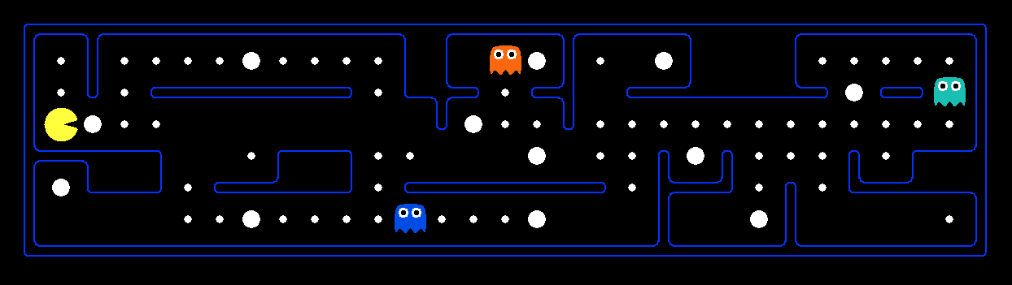
What is a State Space?
The world state includes every last detail of the environment
A search state keeps only the details needed for planning (abstraction)
Problem: Pathing
Problem: Eat All Dots
States:
(x,y) location
States:
(x,y) , dots (booleans)
Actions:
NSEW
Actions:
NSEW
Successor:
Update location
Successor:
Update location and dots
Goal Test:
(x,y) == END
Goal Test:
No dots (all false)
Much of this slide from Berkley AI

Slide 14
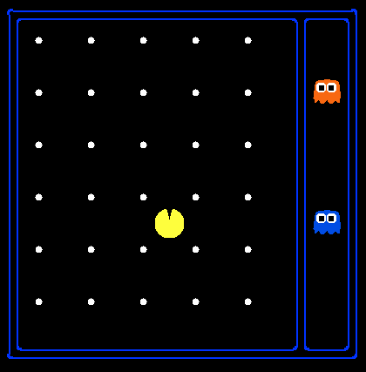
State Space Size?
World State:
Agent position:
120
Food:
30
Ghost positions:
12
Agent facing:
NSEW
How many world states?
120 x 2³⁰ x 12² x 4
States for pathing?
120
States for eat-all-the-dots?
120 x 2³⁰ = 128,849,018,880
Much of this slide from Berkley AI

Slide 15
Quiz: Safe Passage
Problem: eat all dots while keeping the ghosts perma-scared
What does the state space have to specify?
agent position
dot booleans
power pellet booleans
remaining scared time
Much of this slide from Berkley AI
Notes:
Steps to the closest power pellet
Remaining ghost scared time.
Pellet booleans
Pacman location

Slide 16
State Space Graph
State space graph: A mathematical representation of a search problem
Nodes are (abstracted) world configurations
Arcs represent successors (action results)
The goal test is a set of goal nodes (maybe only one)
In a state space graph, each state occurs only once!
We can rarely build this full graph in memory (it’s too big), but it’s a useful idea
Much of this slide from Berkley AI

Slide 17
Search Trees
This is now / start
“N”, 1.0
“E”, 1.0
Possible futures
A search tree:
A “what if” tree of plans and their outcomes
The start state is the root node
Children correspond to successors
Nodes show states, but correspond to PLANS that achieve those states
For most problems, we can never actually build the whole tree
Much of this slide from Berkley AI

Slide 18
State Space Graph vs. Search Trees
Each NODE in the search tree is an entire PATH in the state space graph.
We construct both on demand and we construct as little as possible.
Much of this slide from Berkley AI

Slide 19

Quiz: State Space Graphs vs. Search Tree
Consider this 4-state graph:
How big is its search tree (from S)?
a
S
G
b
Important: Lots of repeated structure in the search tree!
Slide from Russell/Norvig

Slide 20
Tree Search: Example with Romania
Slide from Russell/Norvig

Slide 21
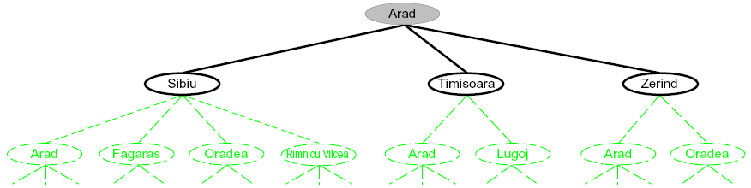
Searching with a Search Tree
Search:
Expand out potential plans (tree nodes)
Maintain a fringe of partial plans under consideration
Try to expand as few tree nodes as possible
Slide from Russell/Norvig

Slide 22
General Tree Search
Important ideas:
Fringe
Expansion
Exploration strategy
Main question: which fringe nodes to explore?
Slide from Russell/Norvig

Slide 23

Depth-First Search (DFS)
Much of this slide from Berkley AI

Slide 24
DFS
Strategy: expand a deepest node first
Implementation: Fringe is a LIFO stack
a
G
a
c
b
c
b
e
d
e
d
f
f
S
h
h
p
p
r
q
r
q
S
d
e
p
b
c
e
h
r
q
a
a
h
r
p
q
f
p
q
f
q
c
G
q
c
G
a
a
Much of this slide from Berkley AI

Slide 25
Search Algorithm Properties
Complete: Guaranteed to find a solution if one exists?
Optimal: Guaranteed to find the least cost path?
Time complexity?
Space complexity?
Cartoon of search tree:
b is the branching factor
m is the maximum depth
solutions at various depths
Number of nodes in entire tree?
1 + b + b² + …. b^{m} = O(b^{m})
1 node
b
…
b nodes
b² nodes
m tiers
b^{m} nodes
Much of this slide from Berkley AI and Russell/Norvig

Slide 26
DFS Properties
What nodes DFS expand?
Some left prefix of the tree.
Could process the whole tree!
If m is finite, takes time O(b^{m})
How much space does the fringe take?
Only has siblings on path to root, so O(bm)
Is it complete?
m could be infinite, so only if we prevent cycles (more later)
Is it optimal?
No, it finds the “leftmost” solution, regardless of depth or cost
1 node
b
…
b nodes
b² nodes
m tiers
b^{m} nodes
Much of this slide from Berkley AI and Russell/Norvig

Slide 27
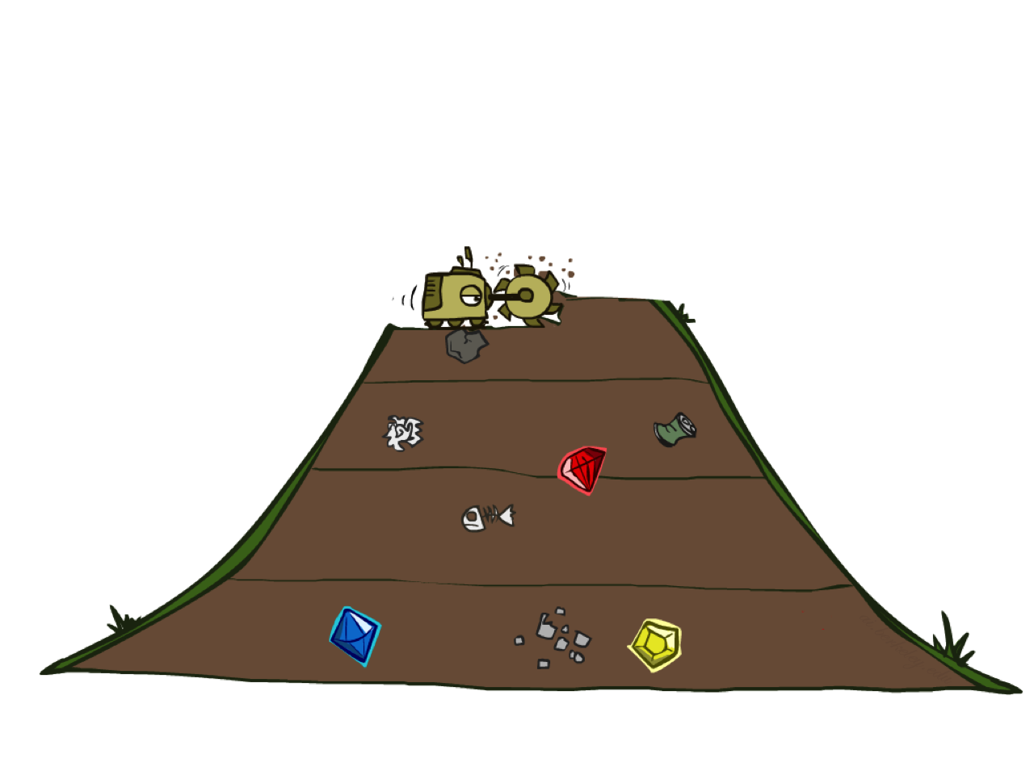
Breadth-First Properties
Much of this slide from Berkley AI

Slide 28
BFS Properties
What nodes does BFS expand?
Processes all nodes above shallowest solution
Let depth of shallowest solution be s
Search takes time O(b^{s})
How much space does the fringe take?
Has roughly the last tier, so O(b^{s})
Is it complete?
s must be finite if a solution exists, so yes!
Is it optimal?
Only if costs are all 1 (more on costs later)
1 node
b
…
b nodes
s tiers
b² nodes
b^{s} nodes
b^{m} nodes
Much of this slide from Berkley AI and Russell/Norvig

Slide 29
Quiz: DFS vs BFS
When will BFS outperform DFS?
When will DFS outperform BFS?

Slide 30
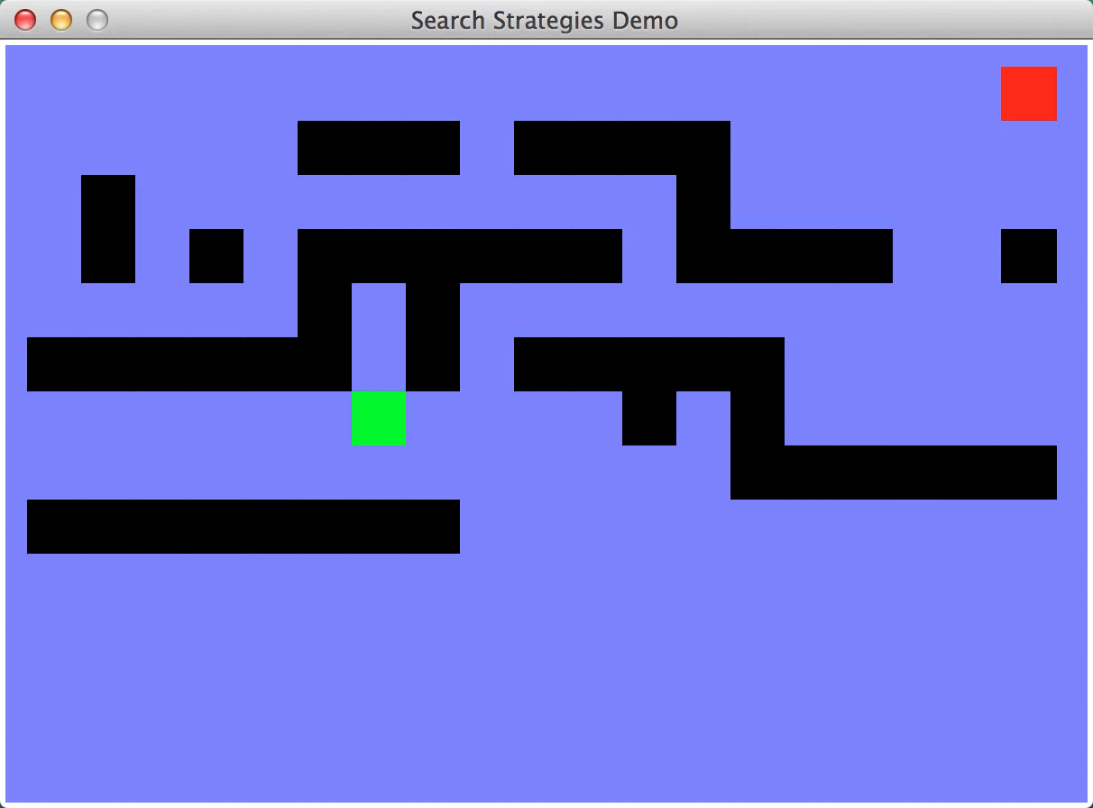

Visualize Search
DFS
BFS

Slide 31
Iterative Deeping Search (IDS)
Idea: get DFS’s space advantage with BFS’s time / shallow-solution advantages
Run a DFS with depth limit 1. If no solution…
Run a DFS with depth limit 2. If no solution…
Run a DFS with depth limit 3. …..
Isn’t that wastefully redundant?
Generally, most work happens in the lowest level searched, so not so bad!
b
…
Much of this slide from Berkley AI and Russell/Norvig

Slide 32
Cost-Sensitive Search
a
GOAL
2
2
b
c
3
2
1
8
2
e
d
f
3
9
8
2
START
h
1
4
2
p
4
r
15
q
BFS finds the shortest path in terms of number of actions.
It does not find the least-cost path. We will now cover
a similar algorithm which does find the least-cost path.
Much of this slide from Berkley AI and Russell/Norvig

Slide 33
Uniform Cost Search (UCS)
What nodes does UCS expand?
Processes all nodes with cost less than cheapest solution!
If that solution costs C* and arcs cost at least ε , then the “effective depth” is roughly C*/ε
Takes time O(b^{C*/ε}) (exponential in effective depth)
How much space does the fringe take?
Has roughly the last tier, so O(b^{C*/ε})
Is it complete?
Assuming best solution has a finite cost and minimum arc cost is positive, yes!
Is it optimal?
Yes! (Proof next lecture via A*)
b
c ≤ 1
…
C*/ε “tiers”
c ≤ 2
c ≤ 3
Much of this slide from Berkley AI and Russell/Norvig

Slide 34
Uniform Cost Issues
Remember: UCS explores increasing cost contours
The good: UCS is complete and optimal!
The bad:
Explores options in every “direction”
No information about goal location
We’ll fix that soon!
…
c ≤ 1
c ≤ 2
c ≤ 3
Start
Goal
Much of this slide from Berkley AI and Russell/Norvig

Slide 35
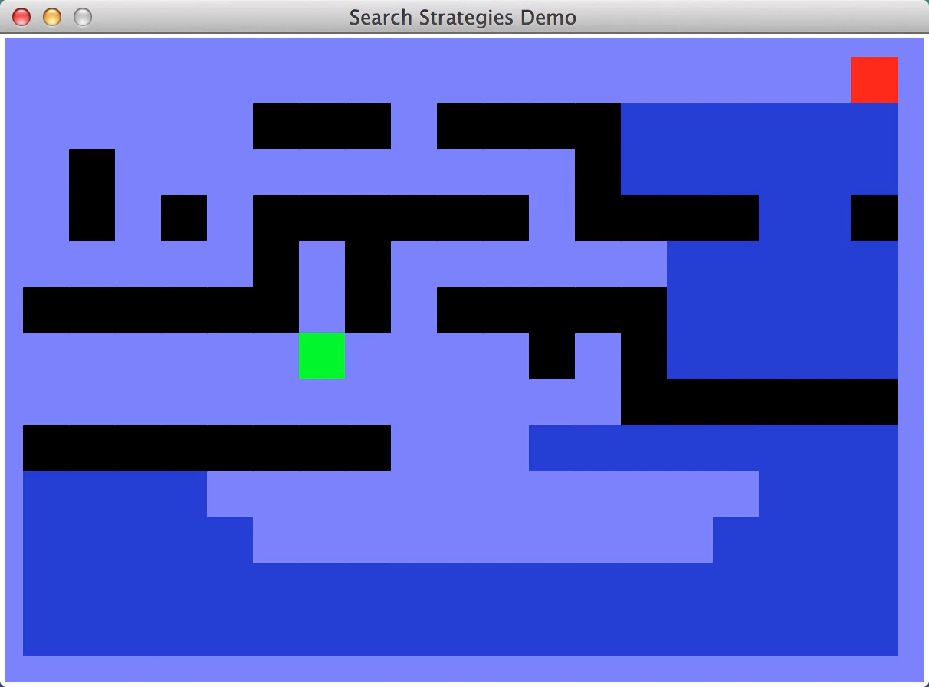
Quiz: Which Search Algorithm is this?

Slide 36
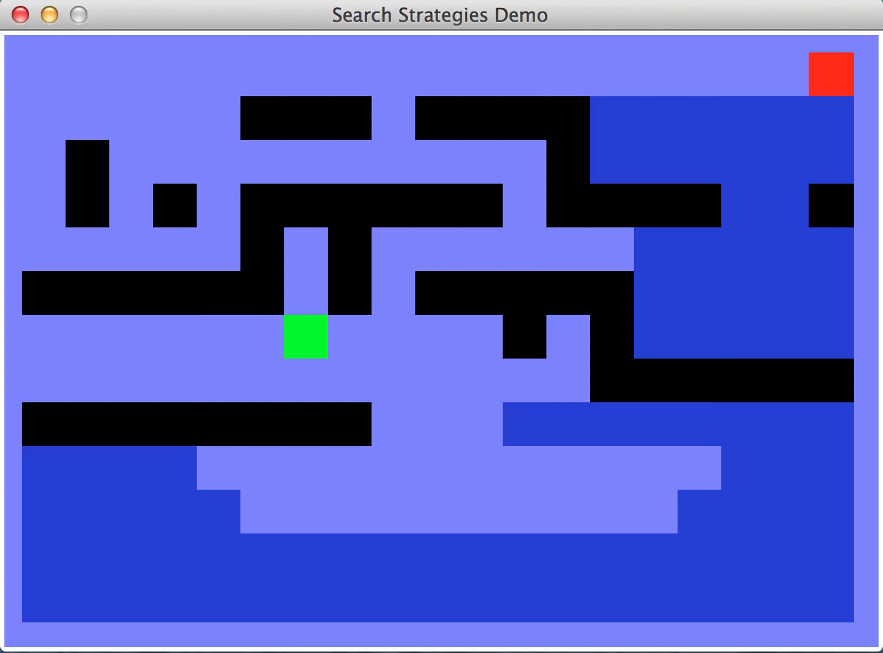
Quiz: Which Search Algorithm is this?

Slide 37
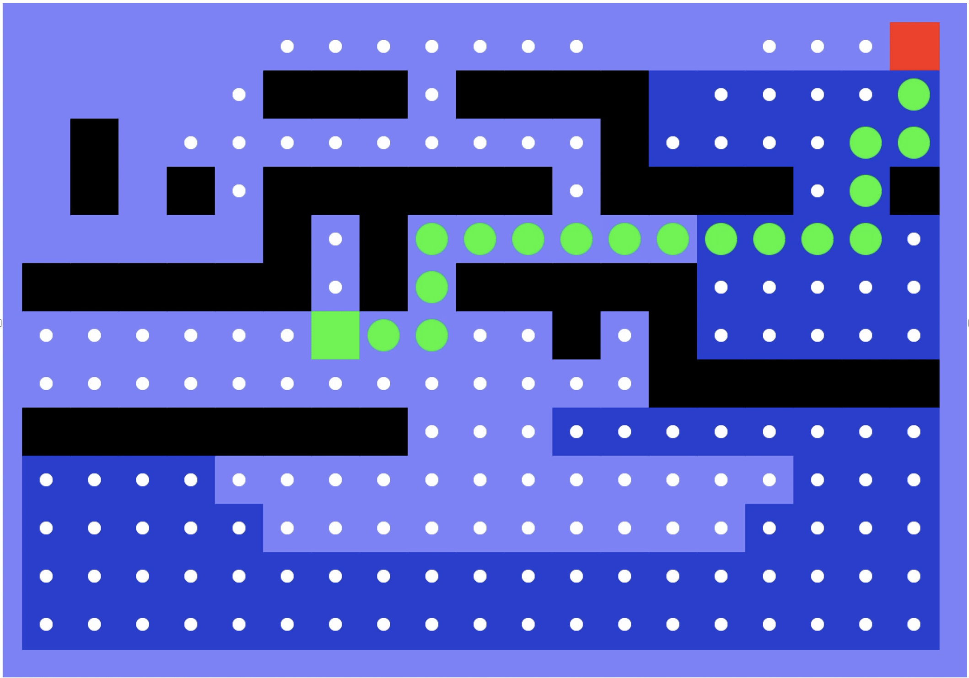
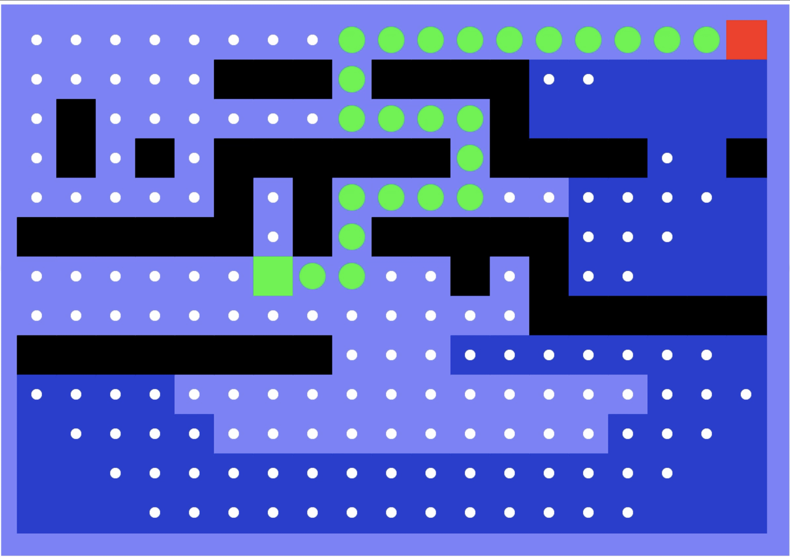
Quiz: Which Search Algorithm is this?

Slide 38

Quiz: Which Search Algorithm is this?

Slide 39

Differences are only in Fringe Management
All these search algorithms are the same except for fringe strategies
Conceptually, all fringes are priority queues (i.e. collections of nodes with attached priorities)
Practically, for DFS and BFS, you can avoid the log(n) overhead from an actual priority queue, by using stacks and queues
Can even code one implementation that takes a variable queuing object
Much of this slide from Berkley AI and Russell/Norvig

Slide 40
For Next Time
HW 0 is due tonight.
HW 0.5 is coming soon (instead of the quiz)
PA 1 is released. You should start on the project now.

